Slide 1
Biathlon Alberta Coaching Seminar 2012
Edmonton, June 9, 2012

Slide 2
Who Is Who?
Richard Boruta, Ch.P.C.
National level athlete (Czechoslovakia)
HP biathlon coach since 1994
Czech, Austrian, German, Russian, Canadian systems
All levels of coaching in Canada (RMR – Olympics 2006)
BATC Head coach

Slide 3
Who Is Who?
Petr Zidek
Trail Grooming experience
Both kids into Canadian Junior National level
Rifle marksmanship
Rifle technician / custom stock builder

Slide 4
Who Is Who?
Rick
Michael
Greg
Airat
Iari
Sam
Jennifer
Bryan
Mark
Lori
Davis
Ray
Julia
Alan

Slide 5
Athletes performance – your coaching record
Meghan Armstrong
David and Andrew Leoni
Robin Clegg
Scott Perras
Zina Kocher
Julia Ransom

Slide 6
Interpretation
Every coach needs to find his or her way of coaching
It is important to stay up-to-date with your knowledge
Stay focused on your goals – big picture
Let your athletes to teach you a lesson
Learn from others, but do not steer away from your course!

Slide 7
Shooting technique
Importance of Prone versus Standing
Great variety of positions and techniques
Consistency is the key
Try to find for everybody as natural position as possible
Allow enough time to stabilize athlete’s shooting skills (avoid major changes close to season)
Always adjust rifle to body and range, don’t try to adjust body to rifle!

Slide 8
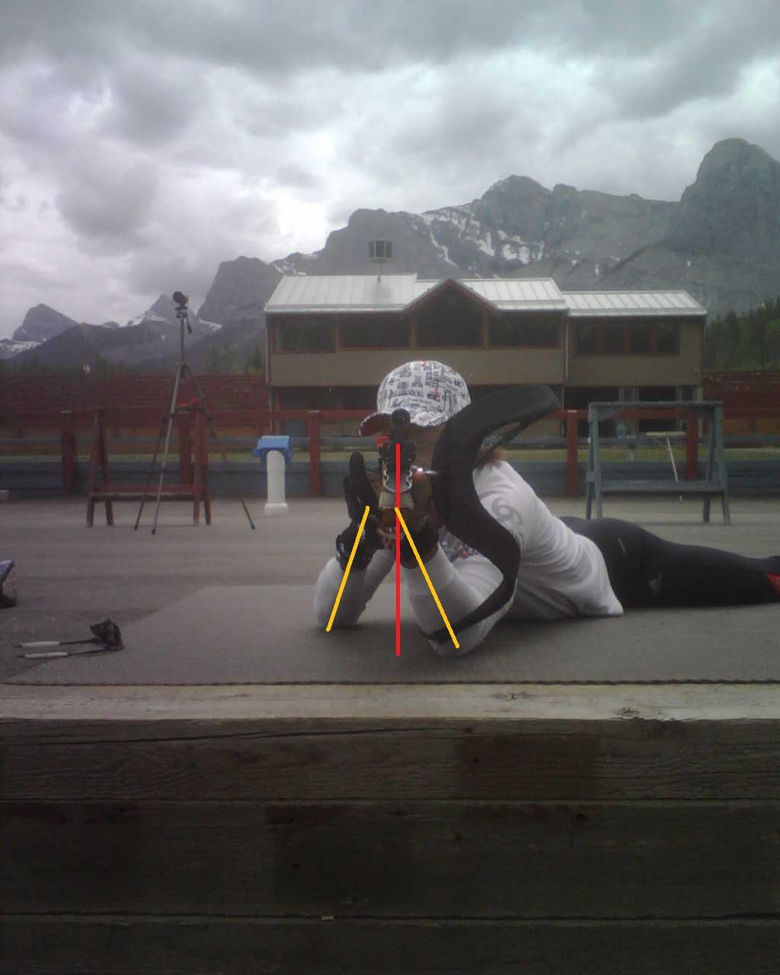
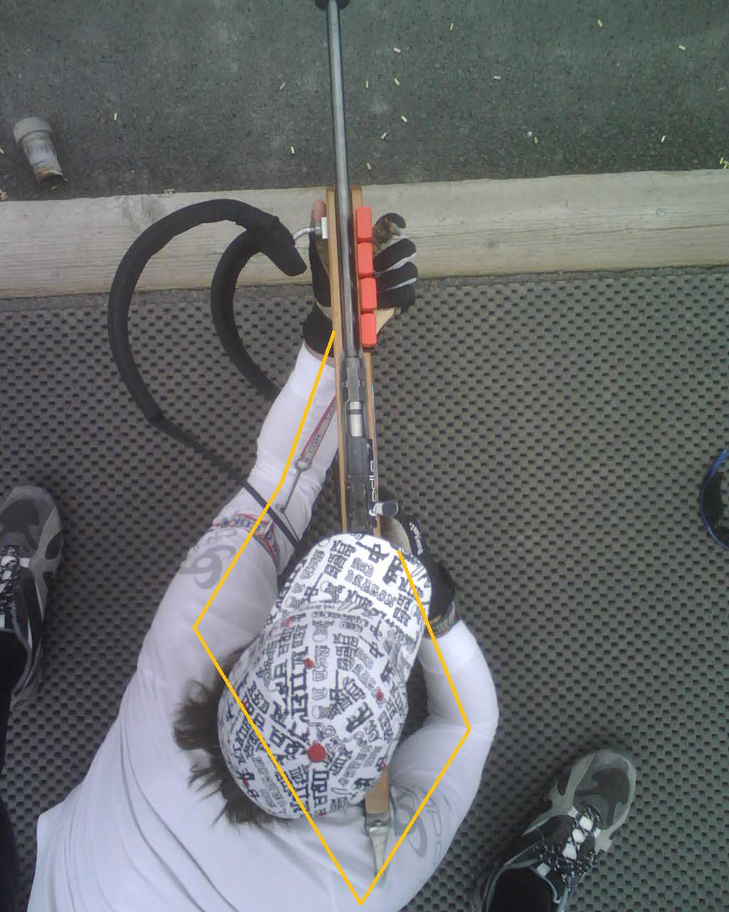
Prone
Easier (better rifle support, body stability)
Basics for breathing, aiming, trigger work

Slide 9
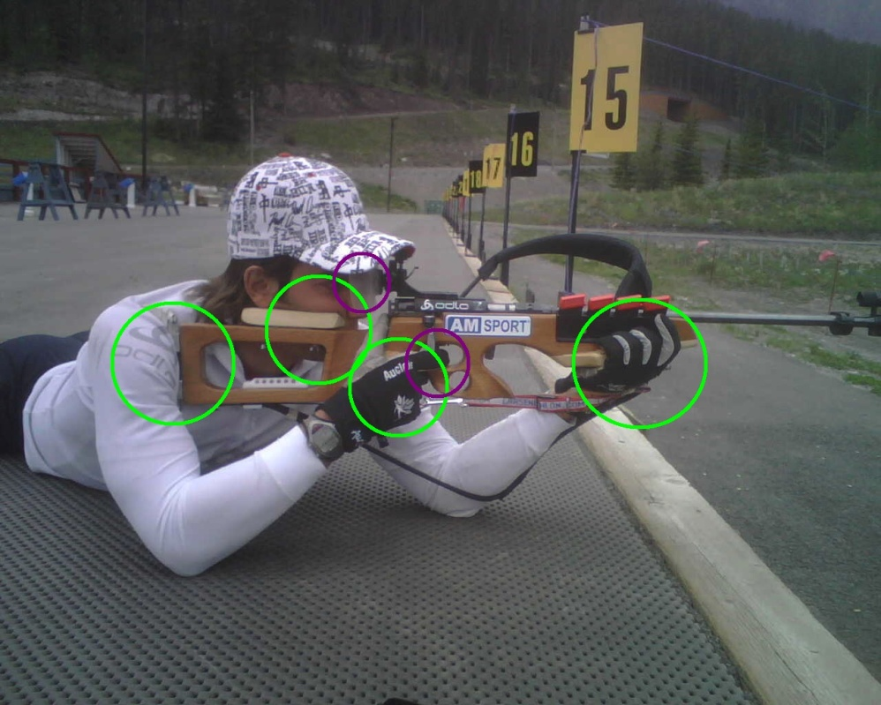
Prone – rifle/body contact points
Consistency is the key to success!
Major vs. minor points

Slide 10
Prone
High x Medium x Low position
Sling tension (Men little more than Women)
Left elbow position slightly left from rifle (right handed)
Head straight up
Back aligned, shoulders and hips square to spine
Shooting order (L-R vs. R-L) changes the tension!
Front sight size (2.8 – 3.5)
Trigger hand/ finger position
Sometimes too long stock!
Breathing patterns – shoot in half exhale!

Slide 11
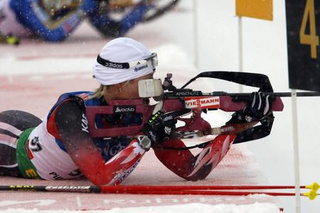
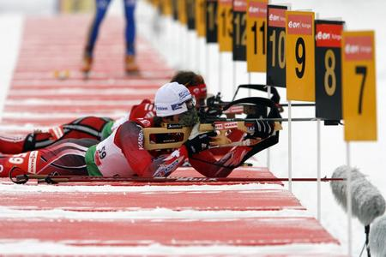
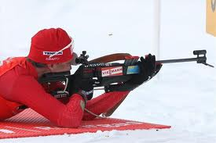
Different prone positions
High Medium
Low

Slide 12
Standing
Maximize stance support
Anatomical grip for left hand
Rifle above center of gravity (middle of feet)
Left hand inside the stance
Proper stock length
Right elbow in natural position (balance x rifle control)
Different breathing patterns than in prone

Slide 13
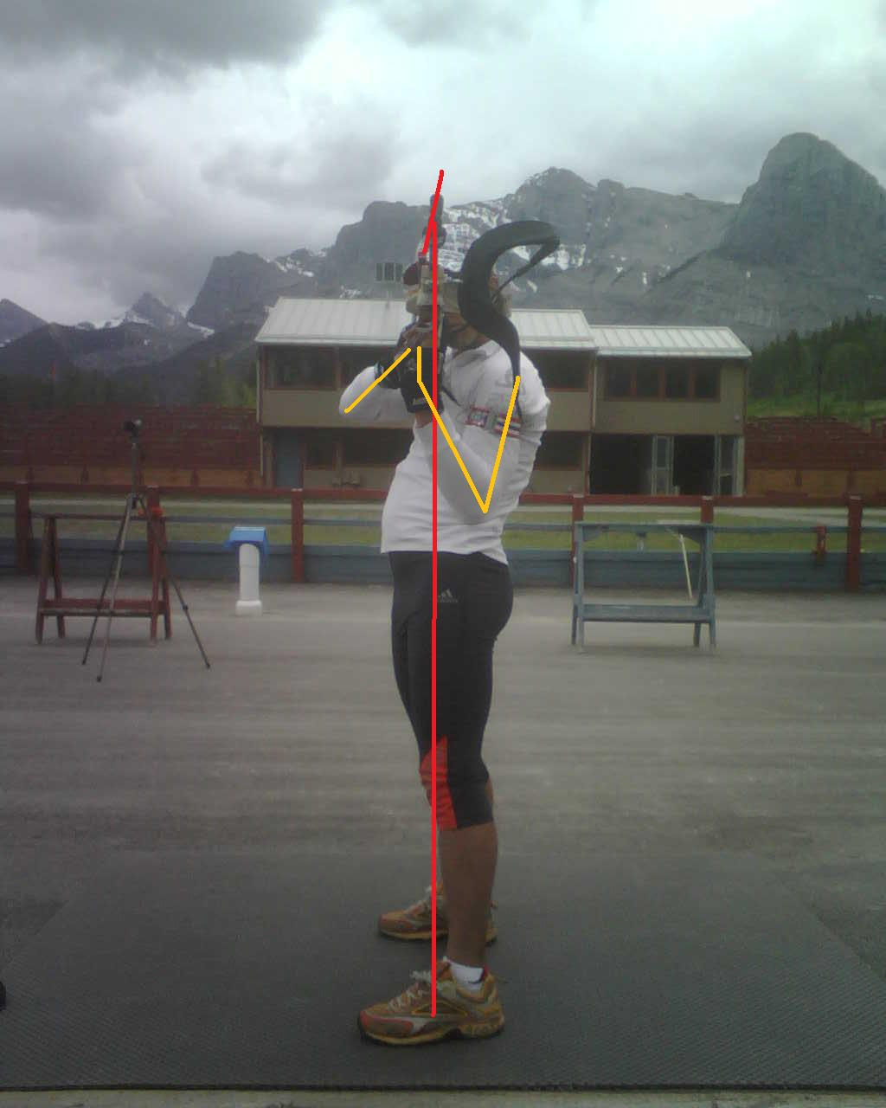
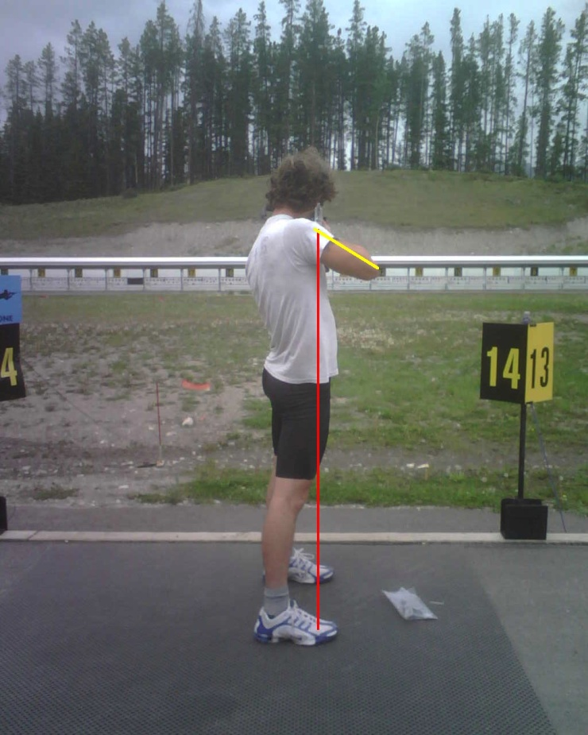
Standing position alignment

Slide 14
Trigger finger position

Slide 15
Trigger work

Slide 16
Focus distribution
Environment, situation, position, trigger, aiming
Where do you want your athletes to focus their aiming eye?
Post vs. circle aperture
Focus during fine aiming - equal distribution between sights and trigger

Slide 17
Position vs. Aiming/trigger

Slide 18
Dry firing
Important for developing specific strength and muscular endurance
Follows and compliments the shooting periodization
How much is enough?

Slide 19
Shooting evaluation
Different shooting tests
Precision shooting (10+10, 20+20, 30+30)
Biathlon shooting (1-shot set-up, 5 across)
French (Bulgarian) test:
10+10 precision
2 min drill (P,P,S,S) 10* # of hits+ (80 –time s)
5x1 shot set-up P/S: time for 5 hits in each position (160-time P; 150-time S)

Slide 20
Shooting evaluation
Need to take into account different conditions on different ranges (indoor, rifle range, biathlon)
Know your ammunition, sometimes it is not the athlete’s fault!
Not always is the best precision shooter also the best shooter in biathlon, but there needs to be a certain standards
Training is designed for practicing different approaches, no need to be concerned about all the percentages. Focus on high intensity shooting!

Slide 21
Range Procedure - Prone

Slide 22
Range Procedure - Standing

Slide 23
Support documents

Slide 24
Correction chart

Slide 25
Dry firing targets Need to be round and proper size!

Slide 26
Shooting periodization
It is very important to treat shooting training the same way as physical training!
There needs to be a general phase (technique / precision), biathlon specific phase (speed, metal targets, skis / RS), low intensity and high intensity overloads as well as rest!
Planning and evaluation (time, number of shots, accuracy)

Slide 27
General preparatory
6-8 weeks, average 5 times a week
Cover your basics: technique, precision
Speed drills
No intensity or easy combo
In average 1 combo per week
Dry firing 4-5 x 20-30 min, mostly holding, position set-up

Slide 28
Specific Preparatory 1
8-9 weeks, 1 no intensity session, 4 combos
Transferring skills into higher intensity workouts
Biathlon speed shooting with focus on maintaining accuracy
Roller ski shooting drills
Time trials
Dry firing 4 x 20 min some holding (mostly S), speed for position set-up, using poles

Slide 29
Competitive Dry Land
2-3 weeks, shooting 4-5 x per week
Biathlon specific testing, roller ski races or TT
Opportunity to rehearse acquired skills, test your taper
First real picture of actual biathlon performance
Dry firing 3-4 per week 10 minutes (trigger technique + set-up speed)

Slide 30
Specific Preparatory 2
7-8 weeks, 4-5 x per week
Last opportunity to work on technique / precision
No more major changes since early October
Dry land + on-snow training
Mostly biathlon-specific drills
Dry firing 4x 20 min

Slide 31
Competitive Period 1
4-5 x per week, based on competition schedule
Selection trials, low key races
Automation of all processes
Dry firing as needed (4 x 10 min), also 2 hrs before the race to fire the neuromuscular coordination!

Slide 32
Competitive Period 2
4-6 x per week, based on the competition schedule
Low volume (usually 50-70 rounds per session)

Slide 33
Transition Period
Do not shoot for at least 4 weeks!
Clean the rifle and do a mechanical check-up.

Slide 34
Short form shooting periodization
September – 4 weeks General Preparatory
October – 4 weeks Specific Preparatory 1 (dry land, skill stabilization)
November – 4 weeks Specific Prep. 2 (dry / on snow, biathlon specific – speed, time trials)
December / January – 9 weeks Competitive 1 (Selections, low-key races)
February/ March – 8 weeks Competitive 2 (Nationals)

Slide 35
Discussion about shooting
Typical errors
Typical misses (1-7-10)
Vostok vs. Anchutz
Air rifles
Various positions
Precision shooting standards
Latest competition trends

Slide 36
Training periodization

Slide 37
Basic Time Table

Slide 38
Yearly planning instrument

Slide 39
Periodization rules
Decide about season’s peak and other important races, than work backwards
Avoid consecutive flat weeks (same hours, same workouts), try to always change the volume or intensity
Regular resting periods
Train hard, but remember good recovery!
Health is # 1
Who is feeling too good in summer, usually doesn’t race well before January

Slide 40
Full Time Periodization
General Preparatory (8-9 weeks)
Specific 1 (8-9 weeks)
Competitive DL (2-3 weeks)
Specific 2 (6-7 weeks)
Competitive 1 (10-11 weeks)
Competitive 2 (8-9 weeks)
Transition (4-6 weeks)

Slide 41
Important
Allow athletes to excel at school
Set up priorities / time lines
Health is the Number 1 issue
Keep positive attitude
Athletes need positive motivation from success (!)
Develop the whole person (Physical + mental development)
Do not specialize too early (some Phys-ed programs are not reliable for teaching good motoric skills)

Slide 42
Specific vs. Non-Specific training
People are born to walk, they need a break from skiing
Controlled sun exposure is important for human body, constant winter is not the best
All the top teams in the world are building general endurance and strength with non-specific activities
Work your inner muscles first (core stability), before you put on your “beach” muscles

Slide 43
Compensating
Many athletes are used to compensate for their weaknesses, rather than trying to improve them
Many athletes develop over-use injuries in the Youth / Junior age, when they want to become serious athletes and they will increase their training volume. They didn’t build proper fitness base in younger age, usually because they were more talented and didn’t need to work hard.
Poor shots are compensating with fast skiing, while good shots can hide poor skiing performance.

Slide 44
Give them clear goals

Slide 45
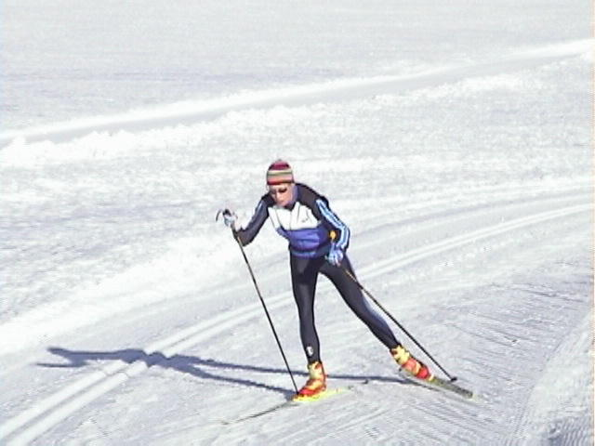
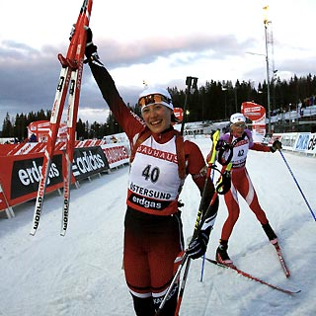
Motivation
Athletes should enjoy the journey,
not just the destination!

